Slide 1

IoT based Digital Water Supply System
FINAL YEAR PROJECT
REVIEW 1
By
Karan Koundinya J 1KS15CS039
Sanjay S.G 1KS15CS087
Teenu Prathyush 1KS15CS113
Vaibhav V 1KS15CS116

Slide 2
PROBLEM STATEMENT
In urban areas the water supply to residence and commercial establishments are provided at a fixed flow rate. There are incidents of excess water drawing by certain customers/users by connecting motor-pump sets to the water lines which is considered as water theft.
Every day, water companies lose 3,123 million litres of water from leaky pipes.
Water theft also impacts law abiding customers, since it leads to higher bills and can disrupt supplies.

Slide 3
OBJECTIVES
In this project, it is proposed that the usage of Anti-theft control system for drinking water supply. By implementing this proposed system; surely it will be able to control the drinking water theft using water flow sensor.
An additional objective of this project is to detect and stop leakage of water using a moisture sensor.
Bill will be generated for each user based on the consumption of water.

Slide 4
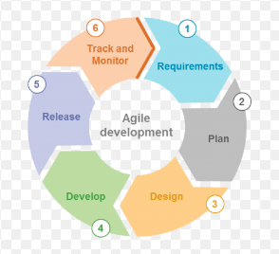
METHODOLOGY
Figure 1 : Agile development methodology

Slide 5
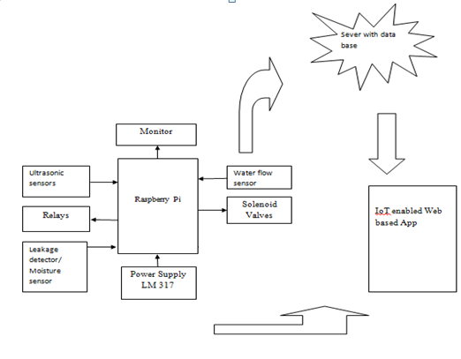
DESIGN
Figure 2 : Block diagram of digital water supply system

Slide 6
TECHNOLOGY USED
Python programming language
Linux (Ubuntu 18.04 LTS)
HTML5
CSS
JavaScript
PHP
MySQL

Slide 7
IMPLEMENTATION
Created front end web application for the user module.
The user can login using his/her username and password credentials.
The user will be redirected to the home page on submission of the login form.
The user can monitor the water level, request for water, pay the bill based on the consumption of water, receive notifications and also contact the admin for any queries.

Slide 8
IMPLEMENTATION (Code)
Login
function submitForm1(action)
{
document.getElementById('form1').action = action;
document.getElementById('form1').submit();
}
Water Level
<section id="portfolio" class="portfolio-section">
<div class="container">
<div class="row">
<div class="columnx1">
<h2>Water Level</h2>
<h3>35 %</h3>
<meter value = "35" min = "0" max = "100"> 35 out of 100</meter><br>
</div></div></div>
</div>
</section>

Slide 9
IMPLEMENTATION (Code) cont.
Request to control
<section id="portfolio" class="portfolio-section">
<div class="container">
<div class="row">
<div class="columnx1">
<p> <h1>User 1</h1>
<form action = "request.php" method = "POST">
<div data-ng-app="" data-ng-init="secs=1;price=2">
<p>seconds:<input type = "number" name = "secs" ng-model="secs"/>
<b>Total in rupees:</b> {{secs * price}}</p> </div>
<p><input type = "submit" name="submit1" value = "submit" />
</p>
</form> </p>
</div></div>
</div>
</section>

Slide 10
IMPLEMENTATION (Code) cont.
Payment
<section id="portfolio" class="portfolio-section">
<div class="container">
<div class="row">
<div class="columnx1">
<p> <h1>User 1</h1>
<h3>Due Amount :40</h3>
<form action = "payment.php" method = "POST">
<p>Enter Amount to pay:<input type = "number" name = "amount" ></p>
<p><input type = "submit" name="submit1" value = "submit" /></p></form> </p>
</div></div>
</div>
</section>

Slide 11
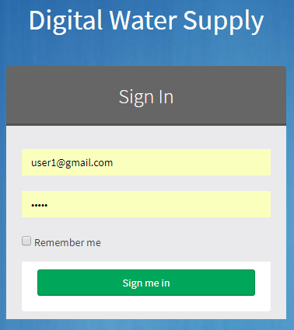
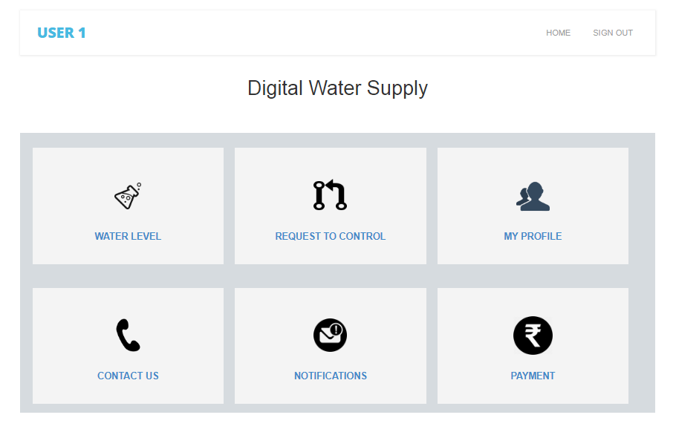
SNAPSHOTS
Login Page User Home Page
Figure 3 : Login Page Figure 4 : User home page

Slide 12
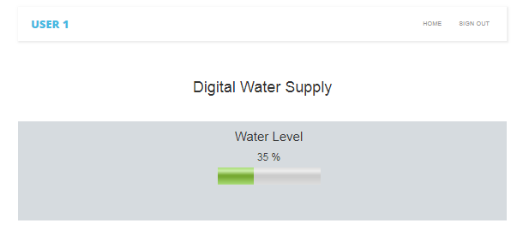
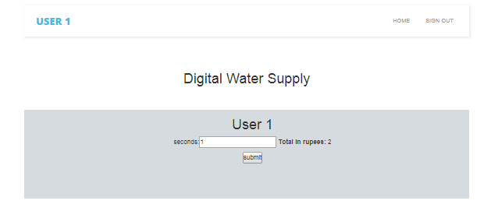
SNAPSHOTS cont.
Water Level Request to Control
Figure 5 : Water level Figure 6 : Request to Control

Slide 13
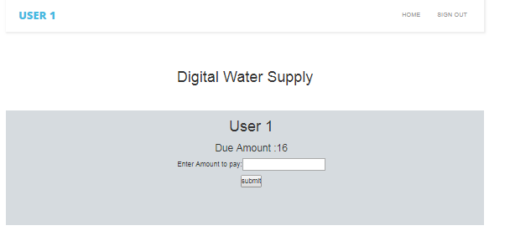
SNAPSHOTS cont.
Bill Payment
Figure 6 : Payment of Bill

Slide 14
REFERENCES
1] Gouthaman.J, Bharathwajanprabhu.R & Srikanth.A “Automated urban drinking water supply control and water theft identification system” Proceeding of the 2011 IEEE Students' Technology Symposium, IIT Kharagpur pp.87-91, 2011.
[2] S.Leirens, C. Zamora, R.R. Negenborn, and B. De Schutter “Coordination in urban water supply networks using distributed model predictive control” Proceedings of the 2010 American Control Conference, Baltimore, Maryland, pp. 3957–3962, 2010.
https://www.w3schools.com/html/default.asp
https://www.w3schools.com/css/default.asp
https://www.w3schools.com/sql/default.asp

